Slide 1
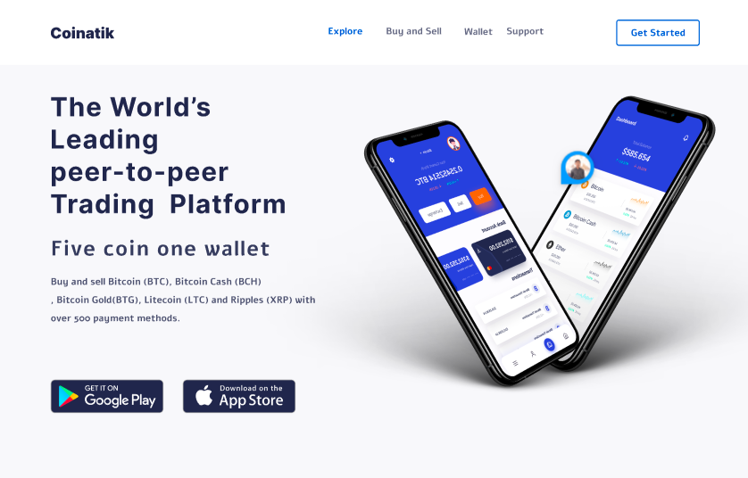
Coinatik
REVOLUTIONIZING PEER-TO-PEER TRADING
MAKING BITCOIN TRADING SWIFT AND SEAMLESS
500+ payment methods
High spending limits
Buy and exchange gift cards
Instant cryptocurrency purchase
Streamlined processes for selling cryptocurrencies with minimal effort
Advanced encryption protocols to safeguard user data
Round-the-clock customer support

Slide 2
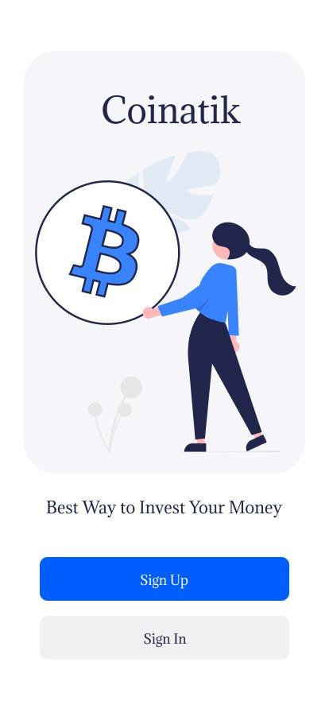
Easy Setup:
Quick and intuitive account setup process to onboard customers effortlessly.
Set passwords and PINs and complete the verification process to get the account rolling.

Slide 3
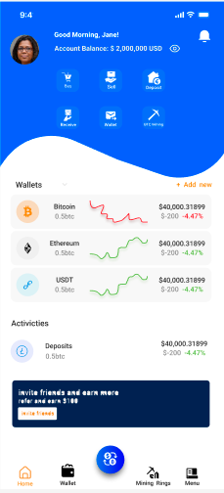
Getting Started:
Check your account balance, advanced charts, indicators, and tools for profound technical analysis.
Seamlessly execute transactions—Buy, Sell, Deposit, Receive, and Mine—with a simple tap, putting the power of financial control in your hands.

Slide 4
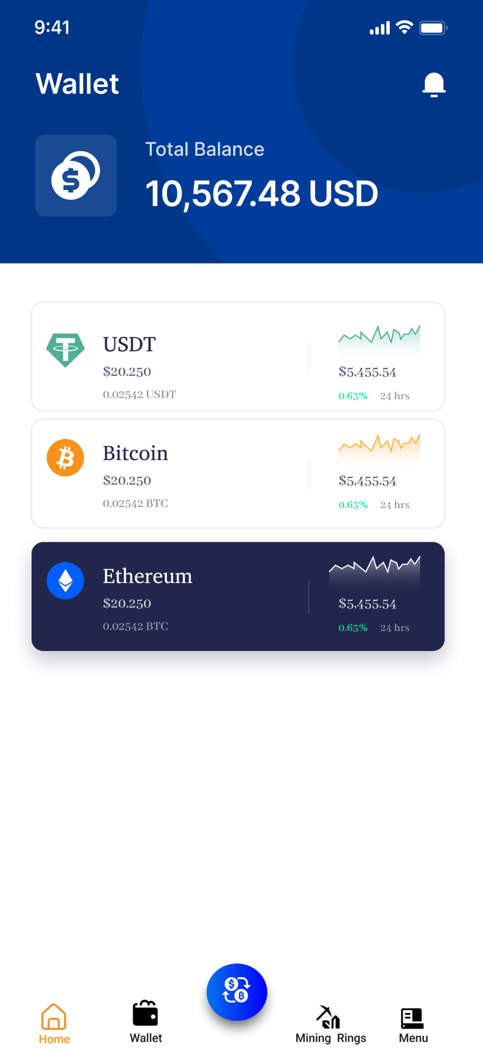
Monitor and Analyse Balance:
Monitor your entire balance and get detailed transaction insights.
With the simplicity of just a few taps, you can manage your assets.

Slide 5
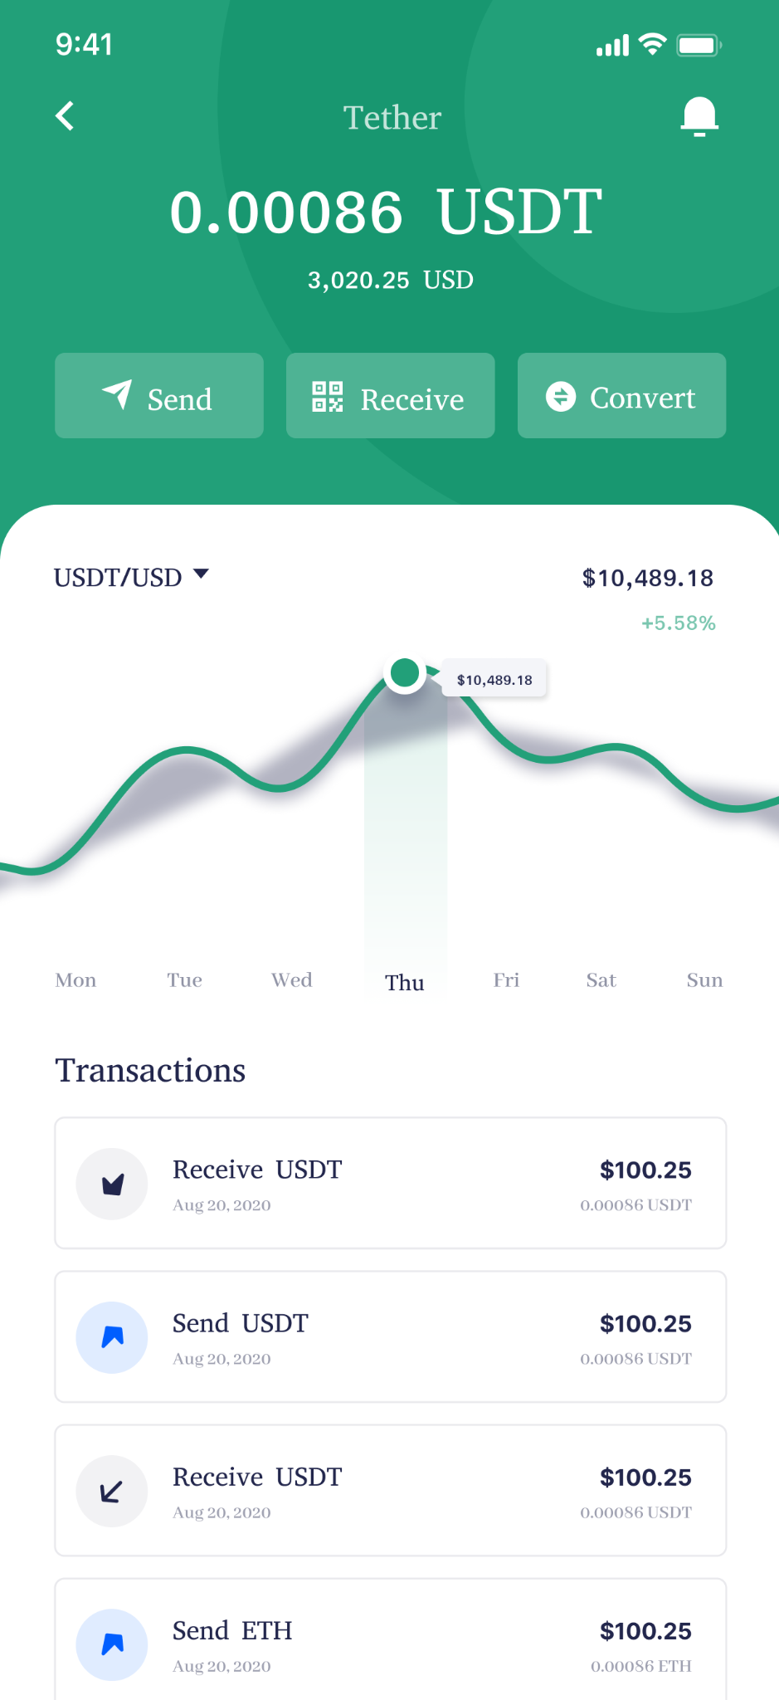
Hassle-free coin transfers:
Input the amount and effortlessly scan the QR Code to transfer coins.
Experience a swift and uncomplicated approach to streamline your trading.

Slide 6
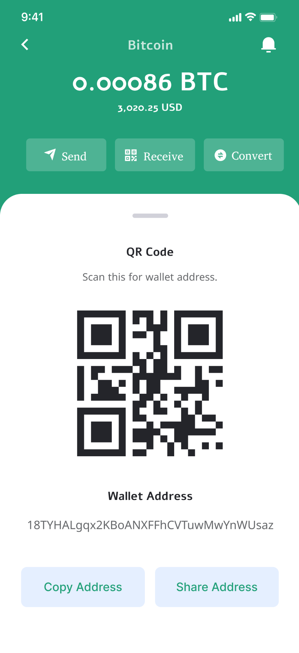
Receive bitcoins:
Just scan your wallet and get the transaction details on the next screen.

Slide 7
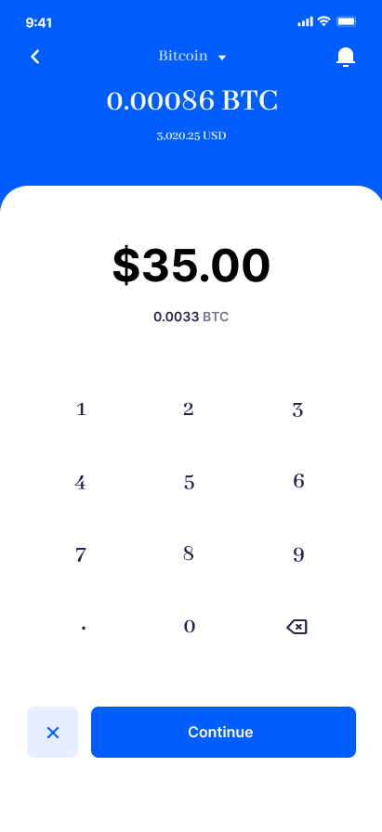
Effortless Coin-to-Dollar Conversion:
Seamless conversion of coins to dollars through our user-friendly, calculator-like interface. Accurate results at your fingertips.

Slide 8
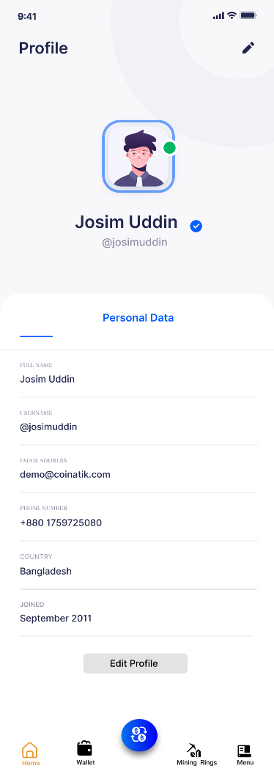
Setup and customize your profile easily:
Set up your profile, insert credentials and preferred payment methods to get started.
Ask for our 24/7 help desk in case of any issues.

Slide 9
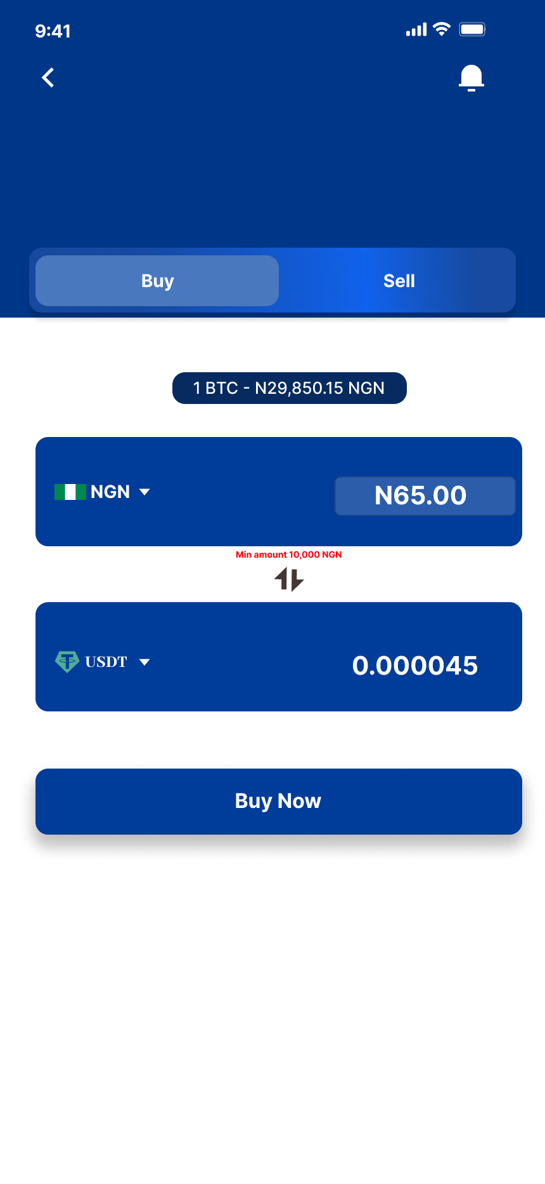
Buy coins:
Buying and selling coins is made easy with us. Interchange the coins and hit “Buy Now”.

Slide 10
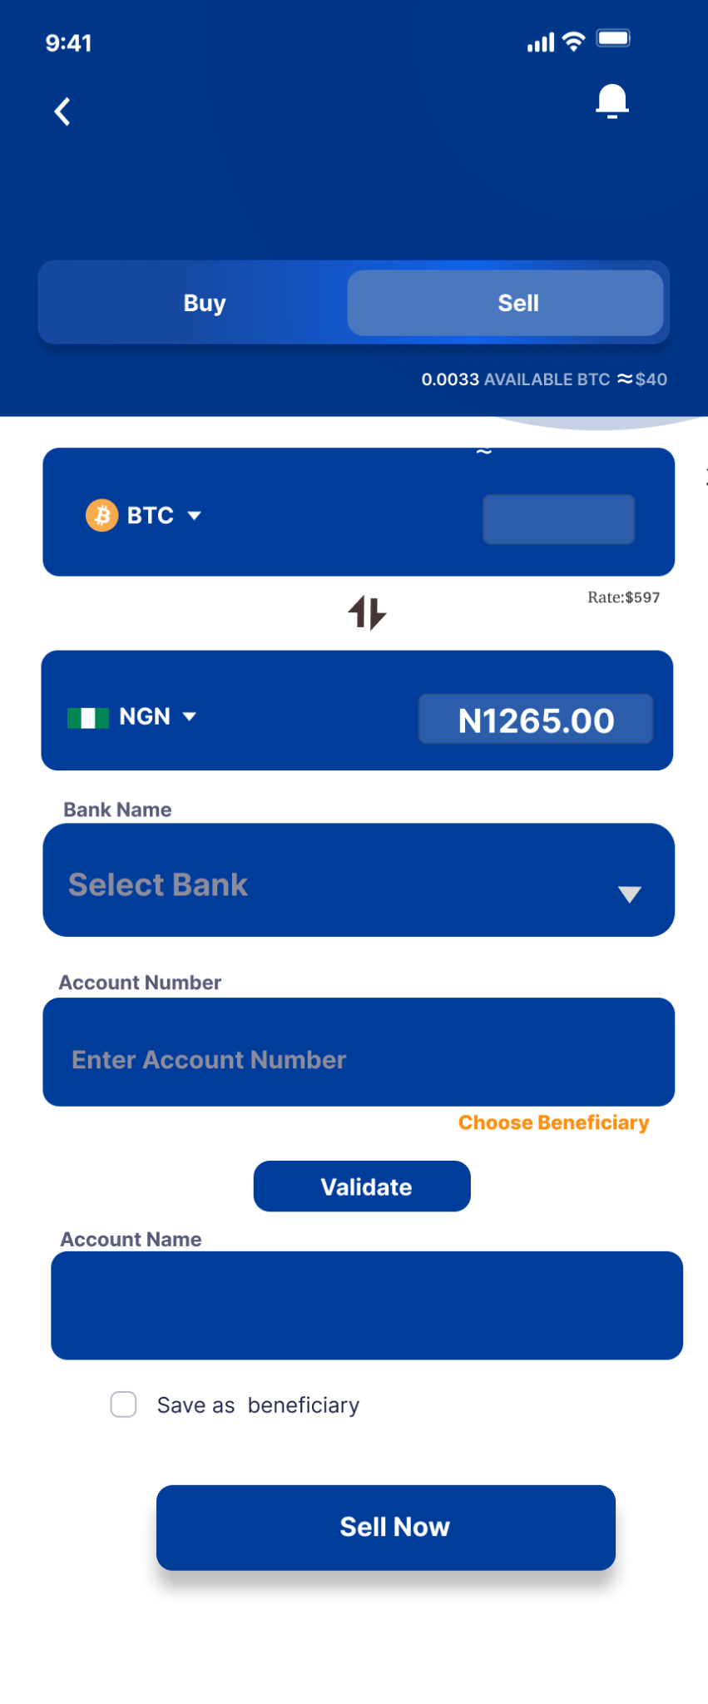
Sell Coins:
Want to sell coins? Just enter the account details, validate the information, and hit Sell Now.

Slide 11
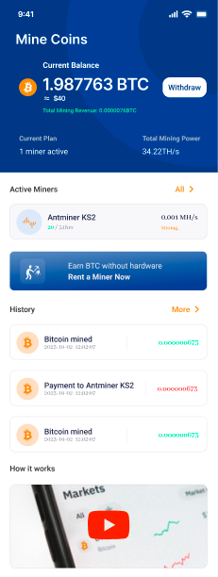
Detailed Mining Dashboard:
Withdraw the balance and see the history of transactions on the interactive dashboard.

Slide 12
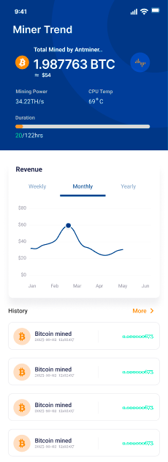
Check Miner Trend:
Make informed decisions by monitoring real-time insights and comprehensive data on mining trends.
Get one step ahead of your peers in the dynamic landscape of cryptocurrency mining.

